Slide 1
When the drugs don’t work…
Nicola Oliver and Ross Hamilton
(IFoA Antibiotic Resistance Working Party)

Slide 2
Agenda
INTRODUCTION
MEDICAL OVERVIEW
MODEL STRUCTURE
PARAMETERISATION
‘RESULTS’ AND NEXT STEPS

Slide 3
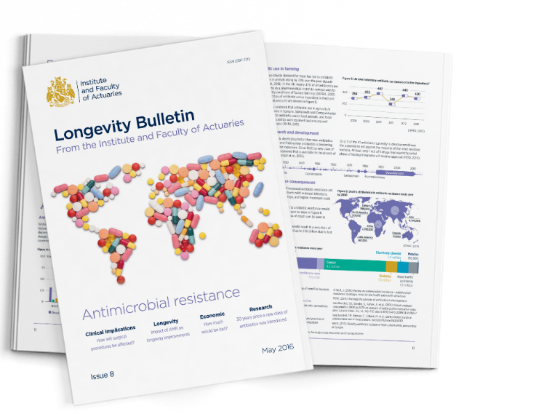
Working party background
ABR Event
Staple Inn
May 2016
Develop a simple modelling framework with plausible parameterisation to allow actuaries to develop their own views on likely and stress mortality impacts
This framework would be developed in a UK context but would be expected to be readily transferable to other countries
Working party started in January 2017

Slide 4
Working party members
Name | Role | Firm
Matthew Edwards | Chair | Willis Towers Watson
Nicola Oliver | Medical input & Deputy Chair | Medical Intelligence
Sheridan Fitzgibbon | Model structure & parameterisation | Legal & General
Craig Armstrong | Parameterisation (2017) | Aviva
Ross Hamilton | Model development | Lloyds Banking Group
Irene Merk | General | SCOR
Roshane Samarasekera | Model development | GAD
Soumi Sarkar | General | Legal & General
Katherine Fossett | General | Barnett Waddingham

Slide 5
Medical overview

Slide 6
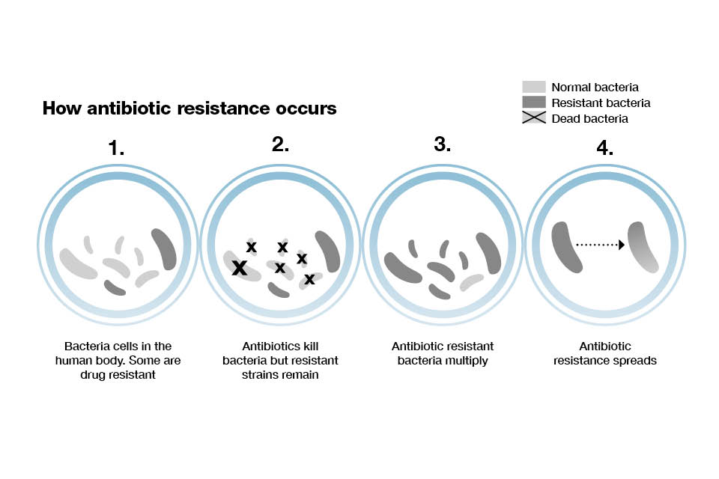
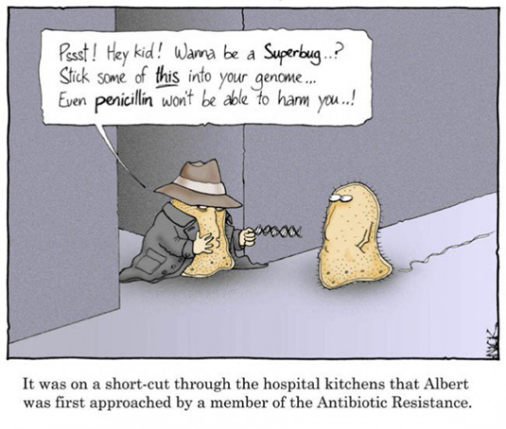
What is antibiotic resistance…
"The thoughtless person playing with penicillin treatment is morally responsible for the death of the man who succumbs to infection with the penicillin-resistant organism.“ Sir Alexander Fleming, 1928
Notes:
Resistance to all antimicrobials, including antivirals and antifungals, is increasing, but of greatest concern is the rapid development of bacterial resistance to antibiotics. If the number of hard-to-treat infections continues to grow, then it will become increasingly difficult to control infection in a range of routine medical care settings and it will be more difficult to maintain animal health and protect animal welfare..
Antibacterial resistance is a natural evolutionary phenomenon that was first identified in 1940. Resistance can arise as a random mutation which is then replicated through reproduction as well as gene exchange.
Some bacteria are naturally resistant; new resistances also arise spontaneously by chance mutations and these resistant strains then multiply. Some resistances can be passed from one bacterium to another, spreading resistance between species. Loops of DNA (called plasmids) carry the resistance genes from one bacterium to another.
When an antibiotic is given, it kills the sensitive bacteria, but any resistant ones can survive and multiply. The more antibiotics are used (in animals and agriculture as well as in man) the greater will be the "selective pressure", favouring resistant strains. This is an example of Charles Darwin's Theory of evolution, operating the "survival of the fittest".
Antibiotics don't cause' resistance; rather, they create an environment which favours the growth of resistant variants which already exist in nature or arise by chance.

Slide 7
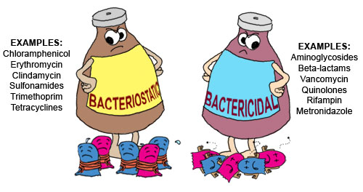
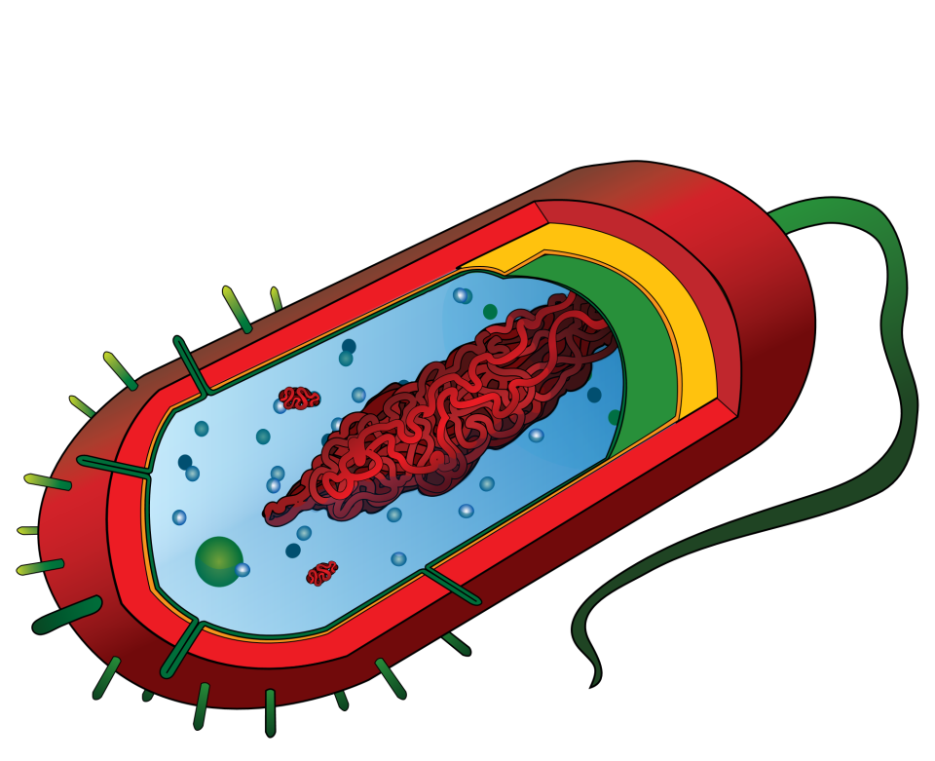

How does it actually work (the science!)
Notes:
Bactericidal drugs are those that kill target organisms. Examples of bactericidal drugs include aminoglycosides, cephalosporins, penicillins, and quinolones. Bactericidal antibiotics kill the bacteria causing the infection through direct action, usually by causing the cells to split open, or lyse. They do this by altering the biochemical pathway through which bacteria make the cell wall. As the antibiotic is taken into the cell, it stops the biochemical machinery of the cell producing or attaching one the major components of cell wall structure.
The cell wall produced is thinner than usual. As the cell divides, the two daughter cells then also have weaker cell walls and they cannot strengthen them because they are also prevented from making all of the necessary components. As they try to divide subsequently, the cell walls of these daughter bacteria fail. Lysis of the cell follows and the bacterium dies. Penicillin antibiotics work in this way, as do the cephalosporins.
Bacteriostatic drugs inhibit or delay bacterial growth and replication. Examples of such include tetracyclines, sulfonamides, and macrolides. Bacteriostatic antibiotics act on the internal workings of the bacterial cell to stop it dividing and so slow down the advance of the infection. A bacterial population that divides more slowly, or that cannot divide at all is much more easily dealt with by the body’s immune system. These antibiotics all tend to work in a similar way, by binding to part of the ribosome structure that controls the synthesis of proteins in the bacterial cell.
Some antibiotics can be both bacteriostatic and bactericidal, depending on the dose, duration of exposure and the state of the invading bacteria. For example, aminoglycosides, fluoroquinolones, and metronidazole exert concentration-dependent killing characteristics; their rate of killing increases as the drug concentration increases.
Cell wall: structure and protection.
Cell membrane: selectively permeable controlling what enters and leave the cell.
Flagellum: movement.
Chromosome: DNA and protein carrying genes.
Ribosome: protein synthesis.
Cytoplasm: liquid portion of the cell in which all metabolic reactions occur.
Plasmid: circular piece of DNA that gives the bacterium special traits such as antibiotic resistance

Slide 8
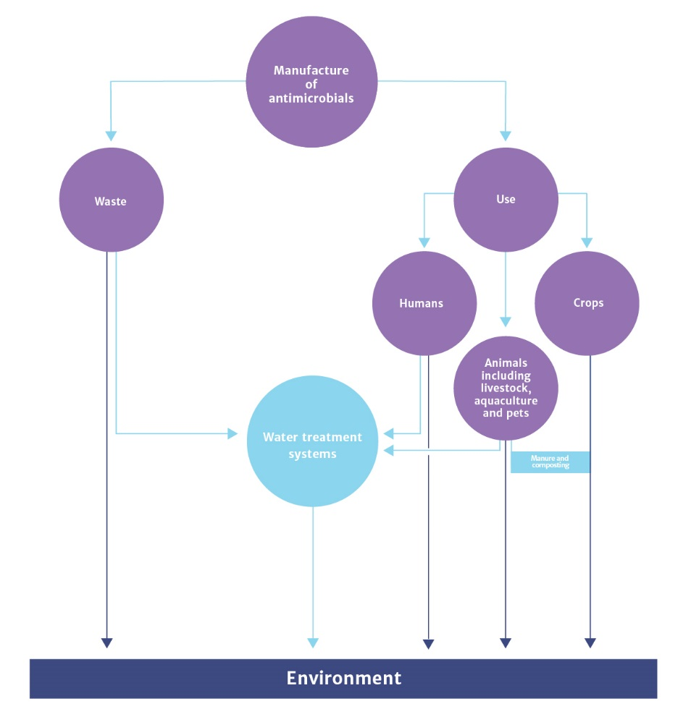
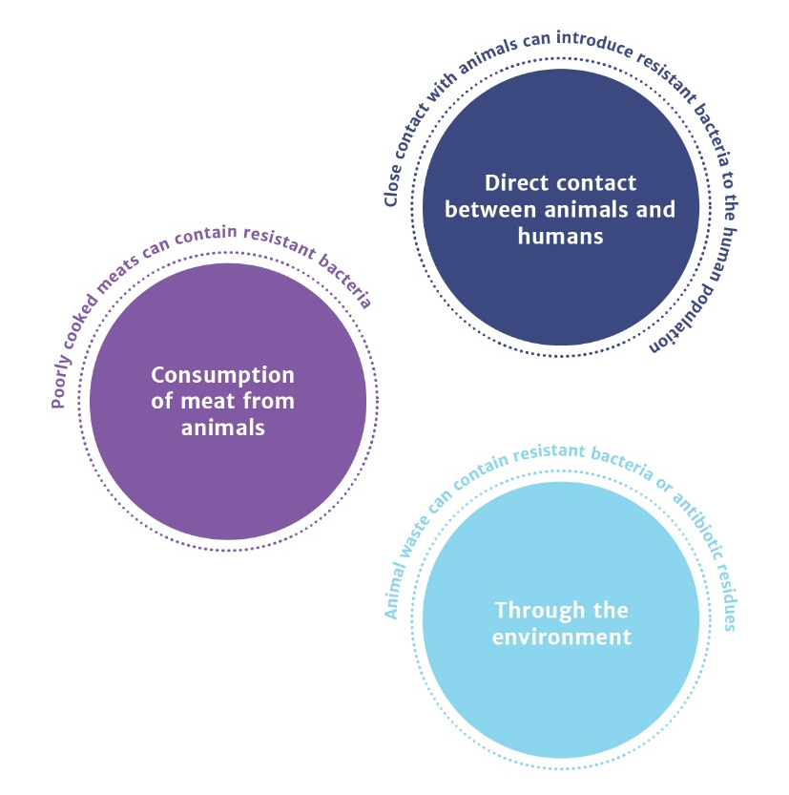
What are the sources of resistance?
Sources of resistance
How animals can pass on resistant bacteria
Infographics sourced from “Review on Antimicrobial Resistance” 2014
Notes:
Discussion on sources of resistance

Slide 9
How does ABR affect people and our work?
Morbidity
Mortality
Septicaemia
Trauma
Pneumonia
Routine cuts and grazes
Chemotherapy
Heart surgery
Meningitis
STIs
Childbirth
Bowel surgery
Joint replacement
0
18
40
60
80
Age (years)
Urinary Tract
Skin and Surgical Site
Respiratory Tract
Abdomen
Notes:
Key points:
ABR affects
Life saving surgery – leading to higher mortality rates
Life improving surgery – leading to less surgery / higher risks of surgery – either way leads to increase costs of healthcare through not having surgery and a poorer quality of life or surgery becoming riskier leading to increased hospitalisation after surgery
Routine healthcare issues – preventative anti-biotics eg. in child birth, trauma / easily treated infections eg. STIs now become greater public health issue and greater risk to the individual – could lead to further more complex treatment
Impact to actuarial work
Current products may be under-reserving / not fit-for-purpose eg. critical illness cover, life insurance
Pension funds may be over-reserving – typical approach is to make an assumption about the long term trend to longevity improvements – will it even be positive?

Slide 10
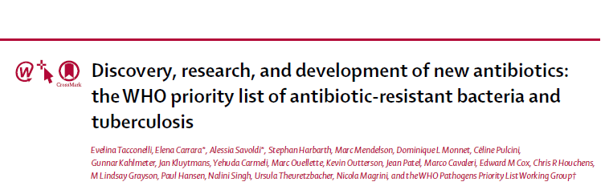
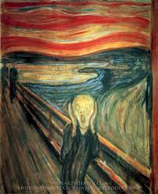
Criteria
Mortality
Health-care burden
Community burden
Prevalence of resistance
10-year trend of resistance
Transmissibility
Preventability in the community
Preventability in health-care setting
Treatability
Pipeline
Acinetobacter baumannii, carbapenem-resistant
Pseudomonas aeruginosa, carbapenem-resistant
Enterobacteriaceae, carbapenem-resistant, 3rd generation
cephalosporin-resistant
Notes:
In 2016, WHO was requested by member states to create a
priority list of other antibiotic-resistant bacteria to support research and development of effective drugs.
Carbapenems are a class of highly effective antibiotic agents commonly used for the treatment of severe or high-risk bacterial infections. This class of antibiotics is usually reserved for known or suspected multidrug-resistant (MDR) bacterial infections. Similar to penicillins and cephalosporins, carbapenems are members of the beta lactam class of antibiotics, which kill bacteria by binding to penicillin-binding proteins, thus inhibiting bacterial cell wall synthesis. However, these agents individually exhibit a broader spectrum of activity compared to most cephalosporins and penicillins.

Slide 11
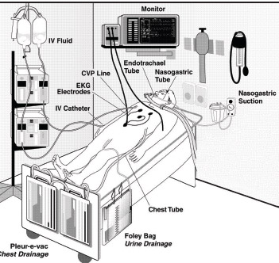
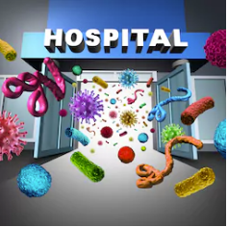
A. Baumannii
Healthcare Setting
Resilient
Resistant to colistin in 4% of cases
Driven by AB use and poor infection control
Acinetobacter baumannii, carbapenem-resistant
Notes:
The clinical significance of A. baumannii is mostly due to its ability to easily acquire resistance to different groups of antimicrobials and to survive for long periods of time on dry surfaces
A baumannii is intrinsically resistant to many antimicrobial agents due to its selective ability to prevent various molecules from penetrating the bacterial outer membrane
A. baumannii infections frequently occur in patients with severe underlying diseases, mainly in the ICU setting, and are often related to invasive procedures or indwelling devices [15,40]. Frequent healthcare-associated infections caused by A. baumannii include pneumonia, bloodstream infections, wound infections, urinary tract infections and meningitis after neurosurgical procedures. rarely been reported as a cause of serious community-acquired pneumonia

Slide 12
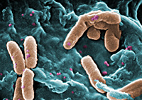
Found widely in the environment
Common cause of mild and serious infections
Risk profile similar to A. Baumannii
Pseudomonas aeruginosa, carbapenem-resistant
Notes:
Pseudomonas infection is caused by strains of bacteria found widely in the environment; the most common type causing infections in humans is called Pseudomonas aeruginosa. Serious Pseudomonas infections usually occur in people in the hospital and/or with weakened immune systems. Infections of the blood, pneumonia, and infections following surgery can lead to severe illness and death in these people.

Slide 13
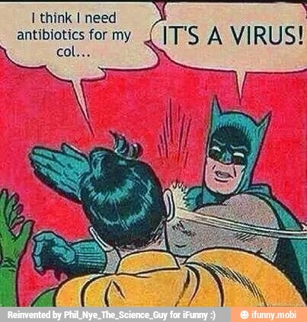
Enterobacteriaceae, carbapenem-resistant, 3rd generation
cephalosporin-resistant
These bacteria are associated with higher frequency of inappropriate antimicrobial therapy, poorer clinical response, and longer length of hospital stay
Third-generation cephalosporin resistance rates in E. coli across Europe, showing the UK, 1999 to 2012 (Department of Health, 2015)
Notes:
Third-generation cephalosporins are broad-spectrum drugs with high intrinsic activity against gram-negative species. The rising resistance to these drugs is worrisome because it could be a proxy for the emergence and spread of Enterobacteriaceae strains producing extended-spectrum Beta-lactamase (ESBL). ESBLs are bacterial enzymes that confer resistance to many highly effective antibiotic classes that can go undetected if conventional testing methods are used in the lab, ultimately leading to treatment failure. In addition, ESBLs necessitate the use of newer and more expensive antibiotics of the carbapenem class. Newer types of beta-lactamase enzymes are diminishing the effectiveness of these last-resort treatments and posing an emerging threat to public health.

Slide 14
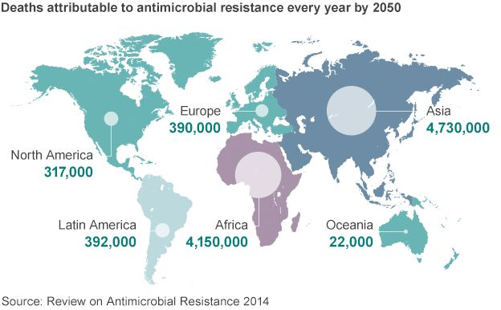
…and why it is important?
“We have reached a critical point and must act now on a global scale to slow down antimicrobial resistance” – Professor Dame Sally Davies, UK Chief Medical Officer
Tackling resistance takes a long time…
Changing behaviours
Developing new antibiotics
Notes:
In 2013 >1.25m people died from cancer.
ABR resistance can’t be ignored

Slide 15

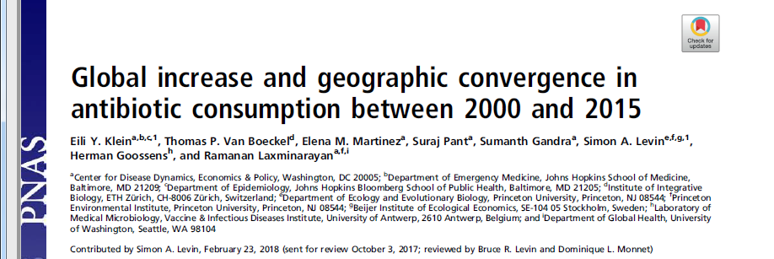
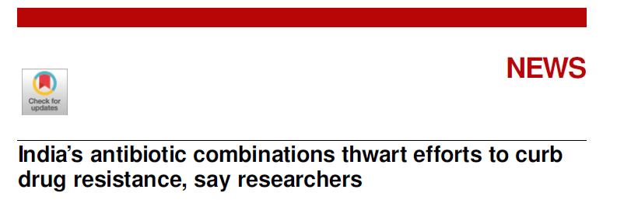
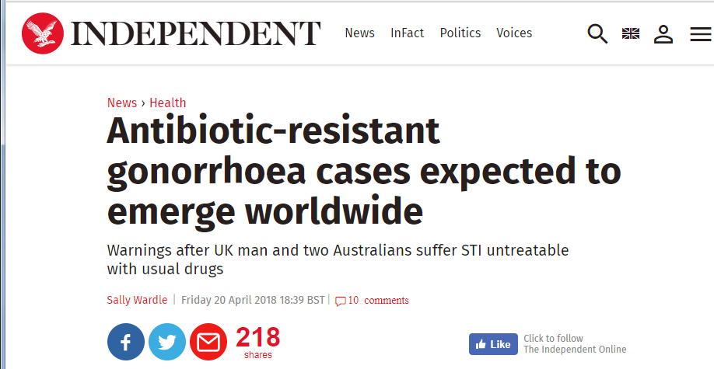
Notes:
Global Increase Study - Between 2000 and 2015, antibiotic consumption, expressed in defined daily doses (DDD), increased 65% (21.1–34.8 billion DDDs), and the antibiotic consumption rate increased 39% (11.3–15.7 DDDs per 1,000 inhabitants per day). The increase was driven by low- and middle-income countries (LMICs), where rising consumption was correlated with gross domestic product per capita (GDPPC) growth.
Rising sales of antibiotic combinations in India could be undermining global efforts to limit antimicrobial resistance, says a study that found dozens of unapproved and sometimes risky formulations on the market.
The problem is compounded by widespread use of drug combinations that mix antimicrobials and other medicines—known as fixed dose combinations (FDCs)—because one or more of the ingredients is usually unnecessary. This fuels overuse and thus resistance, needlessly exposing patients to side effects.
The strain was contracted by a British man who was eventually treated, but it's feared more cases will appear after two more emerged in Australia.
The man had a regular female partner in the UK but picked up the infection after a sexual encounter with a woman in south-east Asia, Public Health England (PHE) said. Initially attempts to get rid of the STI with the usual combination of antibiotics azithromycin and ceftriaxone failed. untreated gonorrhoea in women can cause complications that can lead to infertility and miscarriage. Pain and infertility in men. In rare cases, may lead to septicaemia.
The patient was successfully treated after three days of intravenous treatment with antibiotic ertapenem, the PHE report said

Slide 16
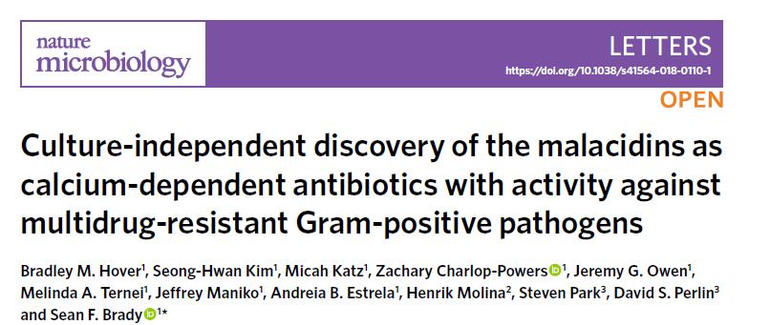
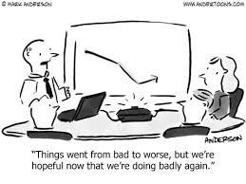
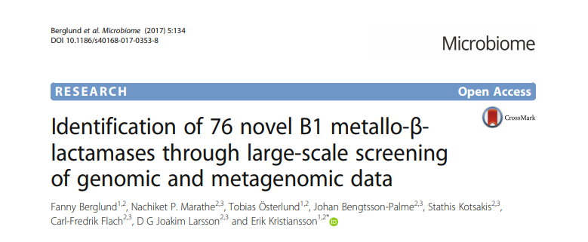
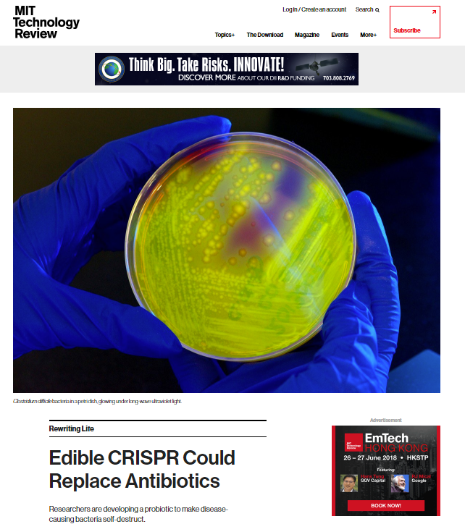
Notes:
Natural products (NPs) made by cultured bacteria have been a major source of clinically useful antibiotics. In spite of decades of
productivity, the use of bacteria in the search for new antibiotics was largely abandoned due to high rediscovery rates. have
developed a culture-independent NP discovery platform that involves sequencing, bioinformatic analysis and heterologous
expression of biosynthetic gene clusters captured on DNA extracted from environmental samples. Here, we describe the application of this platform to the discovery of the malacidins, a distinctive class of antibiotics that are commonly encoded in soil microbiomes but have never been reported in culture-based NP discovery efforts. The malacidins are active against multidrug-resistant pathogens, sterilize methicillin resistant Staphylococcus aureus skin infections in an animal wound model and did not select for resistance under laboratory conditions.
Researchers at Chalmers University of Technology and the University of Gothenburg, Sweden, have found several previously unknown genes that make bacteria resistant to last-resort antibiotics. The genes were found by searching large volumes of bacterial DNA and the results are published in the scientific journal Microbiome. Several of these genes can provide bacteria with the ability to degrade carbapenems, our most powerful class of antibiotics used to treat multi-resistant bacteria.
CRISPR and AB resistance - idea is to use bacteriophage to send a false message to C. difficile, one that instead causes the bacteria to make lethal cuts to its own DNA.
To do it, researchers are developing a bacteriophage capable of carrying a customized CRISPR message. On their own, the bacteriophage would quickly get broken down by stomach acid. So to get the viruses into a person, it is planned to add them to a cocktail of innocuous bacteria, or probiotic, that a person could swallow as a pill or a liquid.

Slide 17
Model structure and parameterisation
Ross Hamilton

Slide 18
How can we model this impact?
Modelling criteria
Simplicity
Availability of data
Appropriate outputs
Basic structure decided on:
Multi-state Markov model
Calibrate to current observed levels of mortality and morbidity
Project varying resistance over time and calculate the change in mortality and morbidity
Notes:
Considered other models:
RAND
KPMG

Slide 19
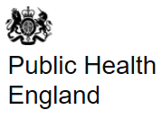



Data sources – what is available?
Current and historical resistance profiles for S. aureus, E. coli and selected other infections vs various antibiotics

Slide 20
Data sources – what is available?
Current and historical resistance profiles for S. aureus, E. coli and selected other infections vs various antibiotics.
Resistance is not absolute. Resistance can be to a single antibiotic, or multidrug resistance.
Bias? Are samples more likely to be taken from the very ill? Will resistant strains be over-represented because of this?

Slide 21
Data sources – what is available?
Incidence rates for bacteraemias.

Slide 22
Data sources – what is available?
Incidence rates for bacteraemias.
Limited data. E. coli monitoring in England goes back to 2013.
Limited evidence for how resistance interacts with incidence.
Bias? Monitoring is of HCAIs.

Slide 23
Data sources – what is available?
Death rates for bacteraemias.

Slide 24
Data sources – what is available?
Death rates for bacteraemias.
Limited data. E. coli monitoring in England goes back to 2013.
Granularity of data:
  Confounding causes of death?
  Academic literature is helpful here.
Large error bounds around estimates of the relative virulence of resistant and susceptible strains.
Bias? The most ill are more likely to be sampled.

Slide 25
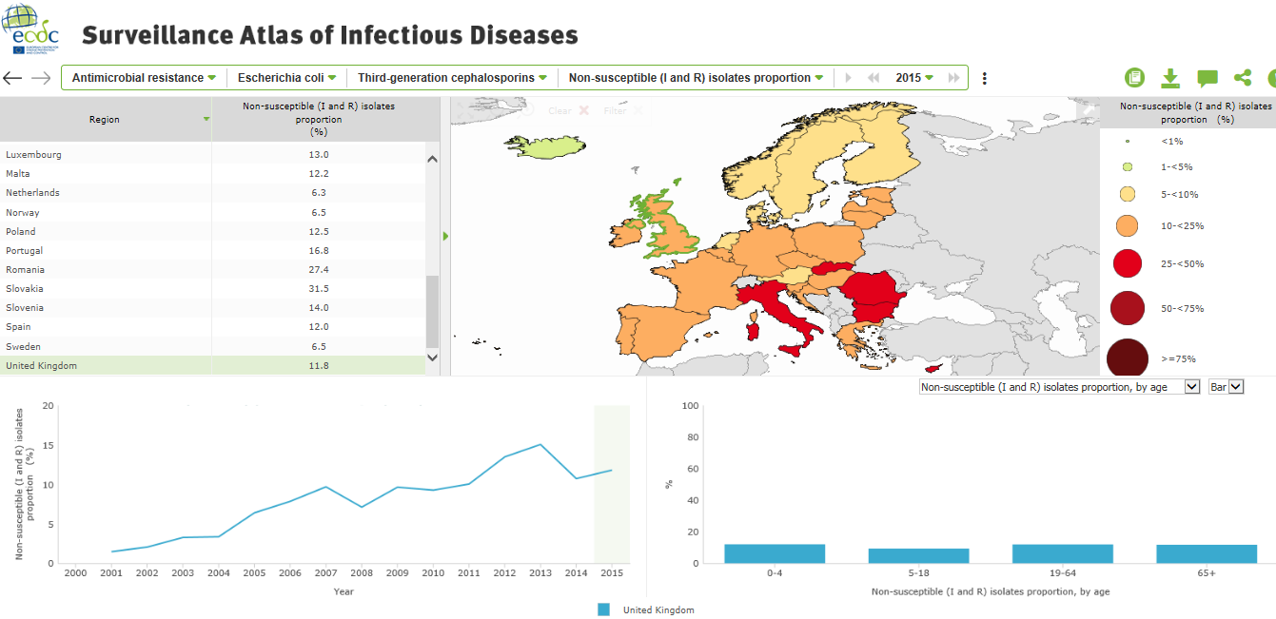
Trends in resistance can be observed…
ECDC EARS-Network has data on how resistance has increased over time

Slide 26

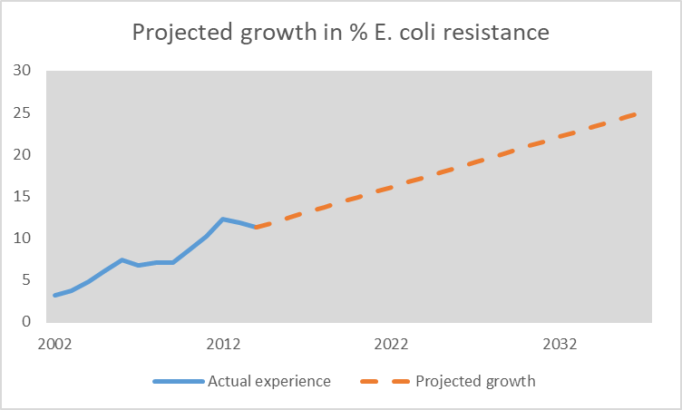
…and extrapolated forwards
This data can be used to inform projections of the future position

Slide 27
…and extrapolated forwards
This data can be used to inform projections of the future position

Slide 28
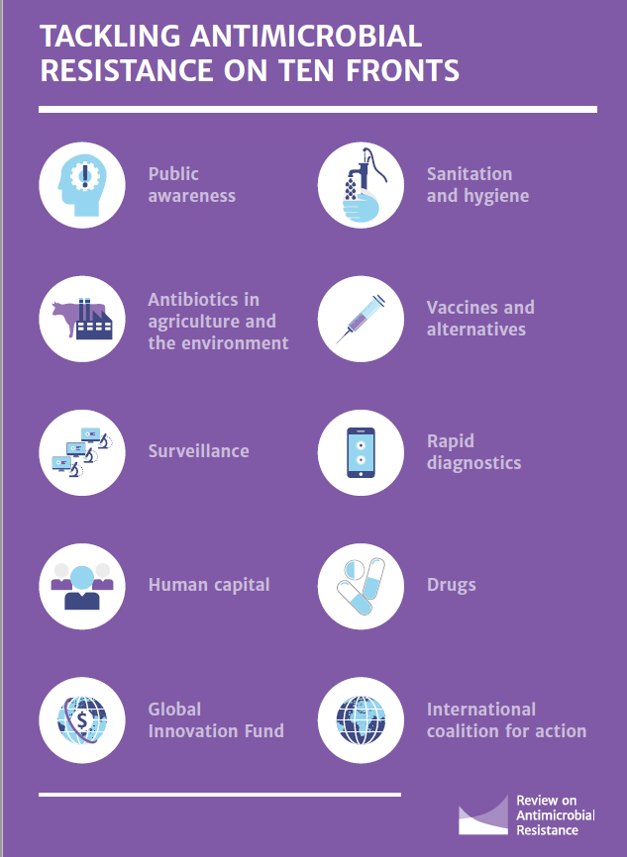
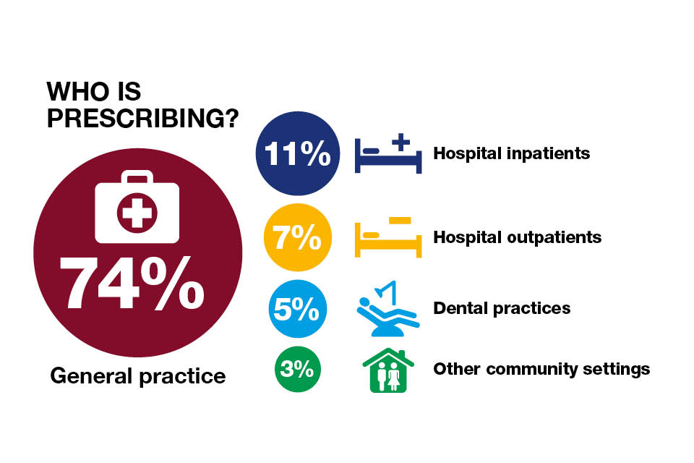
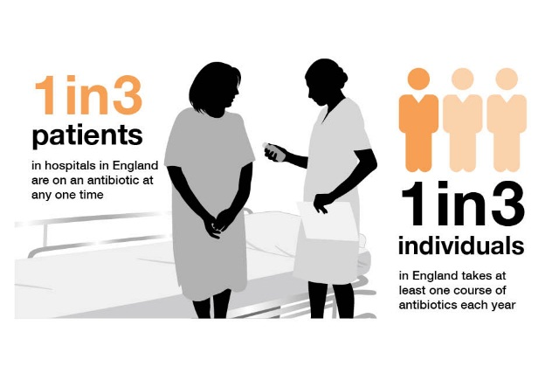
Other considerations
30 years since a new class of antibiotics was last introduced….
Barriers to R&D Investment
Cautious optimism in 2 new compounds
Infographics sourced from “Review on Antimicrobial Resistance” 2014
Notes:
Stewardship is essential

Slide 29
‘Results’ and next steps

Slide 30

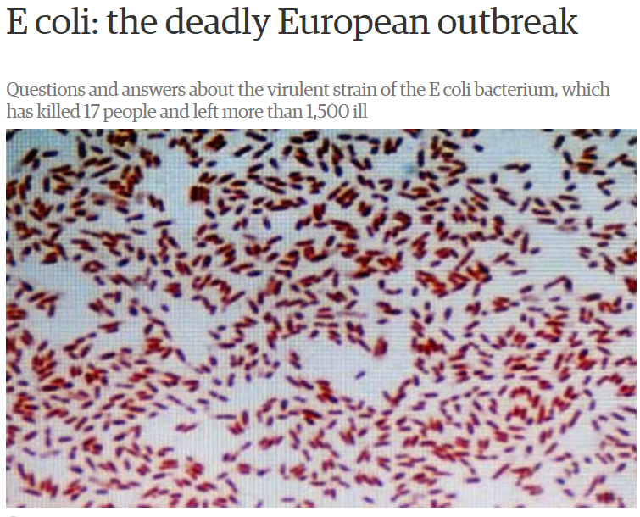
Example Results: E. coli resistance
Initial example parameterisation based on:
  Growth in E. coli bacteria resistant to 3rd generation cephalosporin antibiotics
  Ages 19-64, i.e. working age population
  Projected position in 2037, i.e. 20 years’ time
Under a plausible central scenario there would be a 1% uplift in overall mortality
In an extreme scenario, based on 95% confidence level upper bound, there would be a 2-3% uplift in overall mortality
And this is just for one strain of bacteria …
Model will help actuaries understand the overall impact on mortality/morbidity and quantify the financial impact, even calibrating their own scenarios
Notes:
Considered other models:
RAND
KPMG

Slide 31
Working party – next steps
Sessional meeting
February 2019
Model development
Parameterisation – other main bacteria (5)
Interactions between pathogens
Validation / Documentation
Full model release
Suggested parameterisation based on UK data
Associated paper – main issues relating to sources of ABR, mitigation actions, recent trends, other projection results / methodologies, and background to our model and results from the model

Slide 32
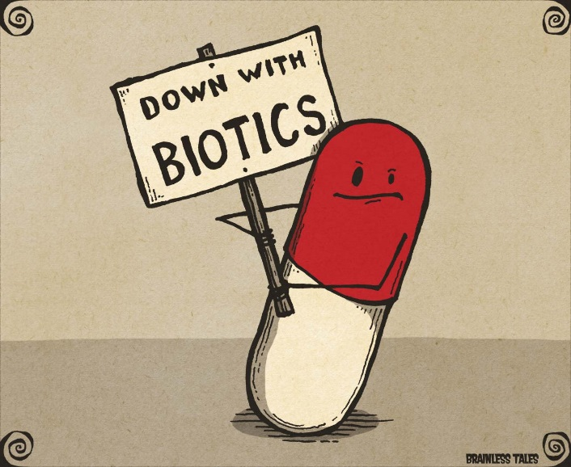
Questions
Comments
Expressions of individual views by members of the Institute and Faculty of Actuaries and its staff are encouraged.
The views expressed in this presentation are those of the presenter.

