Slide 1
Solvency II Appraisal Value (“S2AV”)
Ed Morgan, FIA
Jeremy Kent, FIA
6 March 2018

Slide 2
Disclaimer
The views expressed in this presentation are those of the authors,
Ed Morgan and Jeremy Kent,
of the paper and not necessarily of the
Staple Inn Actuarial Society or Milliman

Slide 3
Agenda
Introduction
Development of S2AV
Comparison with other valuation methods
Further considerations
New business value and profitability
Conclusions

Slide 4
Introduction

Slide 5

Shirley Temple: “Long ago, I became more interested in the real world than in make-believe”

Slide 6
Introduction (1)
Focus on valuing insurance companies under Solvency II (e.g. for M&A)
Investors often interested in shareholder “cash-flows”, i.e. expected real world distributable profits
Traditionally this meant projection of statutory profits with “Solvency I” capital locked in for life (like TEV); discounted cash-flow models often used for non-life
Although we recognize there can be other constraints on dividend paying capacity, we believe the most important drivers, particularly in the medium to long term, of distributable profits will be:
  Required level of Solvency II capital
  Own Funds available and eligible to cover it

Slide 7
Introduction (2)
Aim is to calculate NPV (future expected distributable profits) @ investor’s required rate of return
In practice it is sometimes challenging to get long term projected Solvency II balance sheet and capital requirements (particularly in M&As).
Our method aims to decompose the value into different components, more easily valued based on likely available information from Solvency II reporting
Decomposition useful in understanding value of certain activities, e.g. new business sales, asset management
Equally applicable to life, non-life and health.

Slide 8
Development of S2AV

Slide 9
Base formula
Assume:
  No hedgeable risks taken (and projected SCR same as that backing risk margin)
  No future new business
  Required capital = 100% of SCR
  Tax rate zero
  Assets earn risk-free
  Eligibility rules reflect economic value of Own Fund items
  then……
  S2AV = NPV(distributable profits) = OF + RM – (COC_{SCR}+COC_{RM})

Slide 10
Base formula (2)
Further, if:
  Shareholders’ required rate of return = risk-free + 6%
  Then…..
  RM = (COC_{SCR}+COC_{RM})
  So………………..

Slide 11

Base formula (3)
  S2AV = OF

Slide 12
Base formula (4)
NPV = Own Funds

Slide 13
Base formula – proof
Distributable profit (t)
NPV(distributable profits)

Slide 14
Base formula – proof (2)
If RDR = i% + 6%:

Slide 15
Base formula – proof (3)

Slide 16
Tax, target capital, shareholders’ required return
Introduce:
  Tax at rate tax % (assume taxable basis = Solvency II)
  Target solvency ratio TSR %
  Shareholders’ required rate of return = RDR % (not RF + 6%)
Our expression generalizes to:
S2AV = NPV(distributable profits) @ RDR
= OF + RM * (1-tax) – TSR * COC_{SCR} - COC_{RM}
Projection of SCRs for non-hedgeable risks may be able to be derived from risk margin calculation

Slide 17
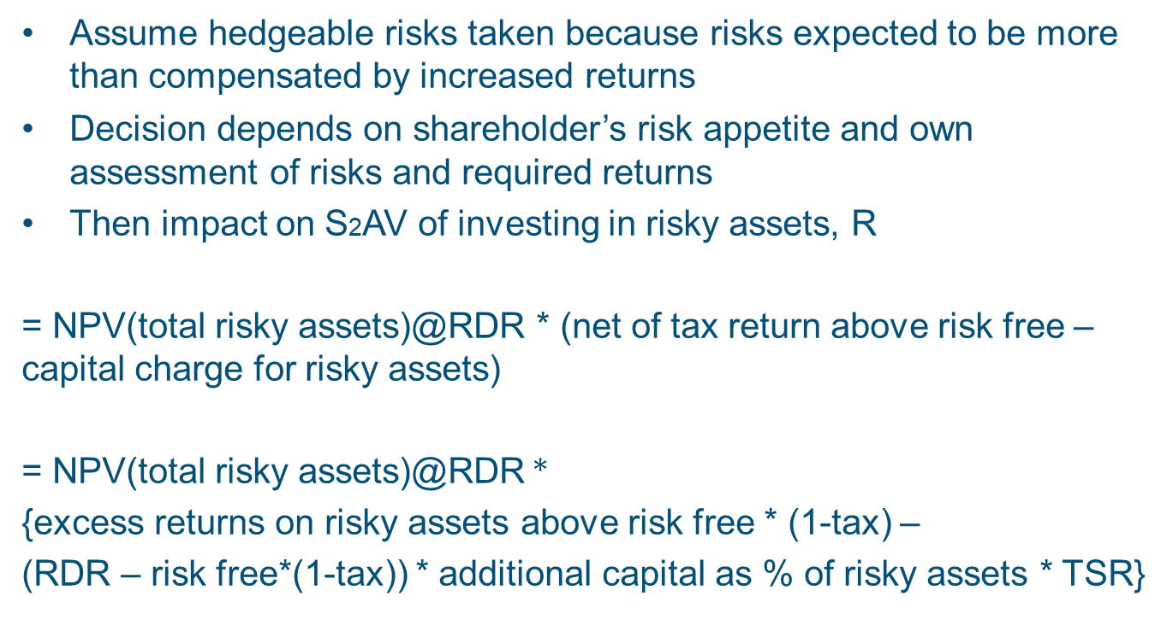
Hedgeable risks
Assume hedgeable risks taken because risks expected to be more than compensated by increased returns
Decision depends on shareholder’s risk appetite and own assessment of risks and required returns
Then impact on S2AV of investing in risky assets, R
= NPV(total risky assets)@RDR * (net of tax return above risk free – capital charge for risky assets)
= NPV(total risky assets)@RDR *
{excess returns on risky assets above risk free * (1-tax) –
(RDR – risk free*(1-tax)) * additional capital as % of risky assets * TSR}

Slide 18
Hedgeable risks (2)
By allowing value to be created (or destroyed) through holding risky assets we have made important departure from market-consistent methodology:
  Market-consistency => additional return expected on assets cancelled by additional risk (market price reflects market view of risk)
  S2AV => reflects investor’s view of additional return, with risk reflected through capital and shareholders’ required rate of return
Assumptions that excess returns and additional capital remain constant proportions of risky assets can be refined.
Additional capital may be impacted by diversification benefit and LACDT

Slide 19

Pirate: “Absorbent and yellow and porous is he.”
[The importance of LACTP and LACDT]

Slide 20
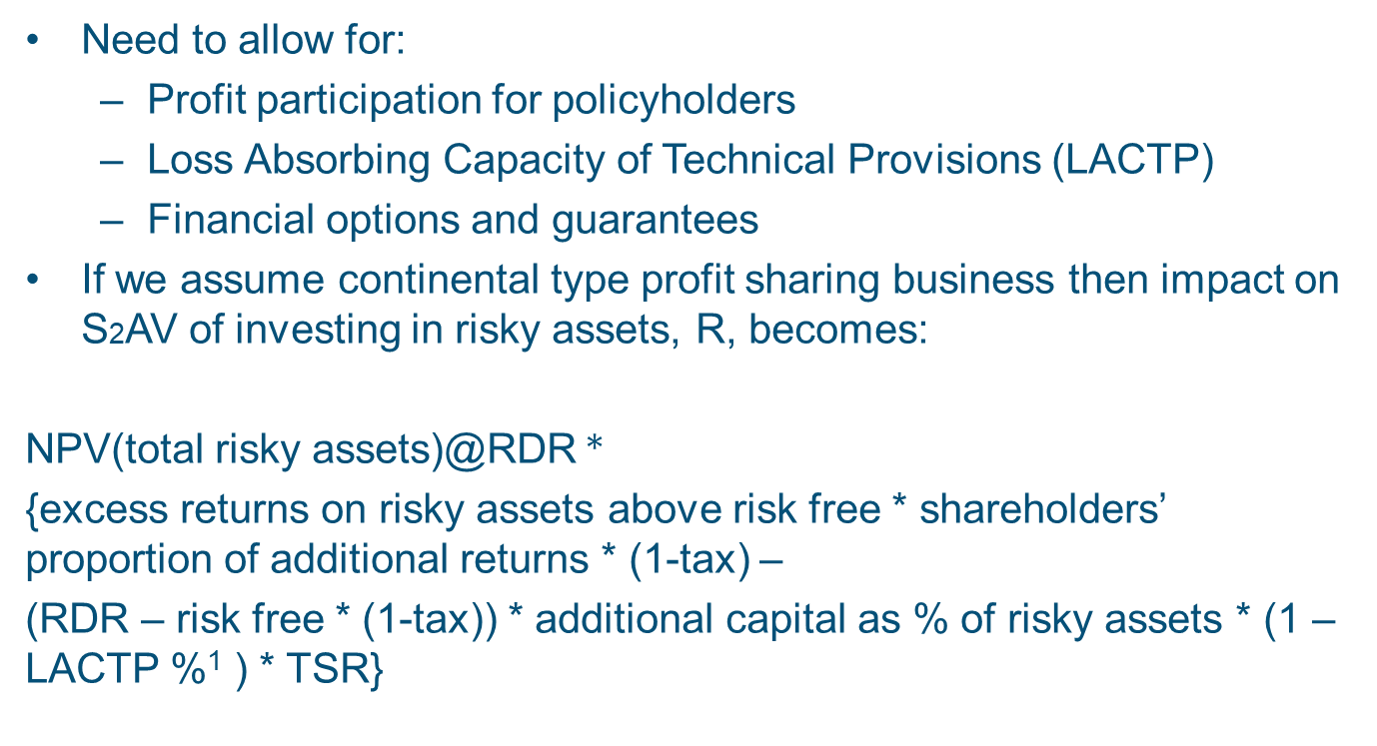
Participating business
Need to allow for:
  Profit participation for policyholders
  Loss Absorbing Capacity of Technical Provisions (LACTP)
  Financial options and guarantees
If we assume continental type profit sharing business then impact on S2AV of investing in risky assets, R, becomes:
NPV(total risky assets)@RDR *
{excess returns on risky assets above risk free * shareholders’ proportion of additional returns * (1-tax) –
(RDR – risk free * (1-tax)) * additional capital as % of risky assets * (1 –LACTP %¹ ) * TSR}
¹ % of additional capital

Slide 21
Example
Assume the following profit sharing formula:
Policyholder return = max(earned rate * 80% , min gtee)

Slide 22
Example (2)
Fix guarantee at 1%, and vary % in risky assets:

Slide 23
Comparison with other valuation methods

Slide 24
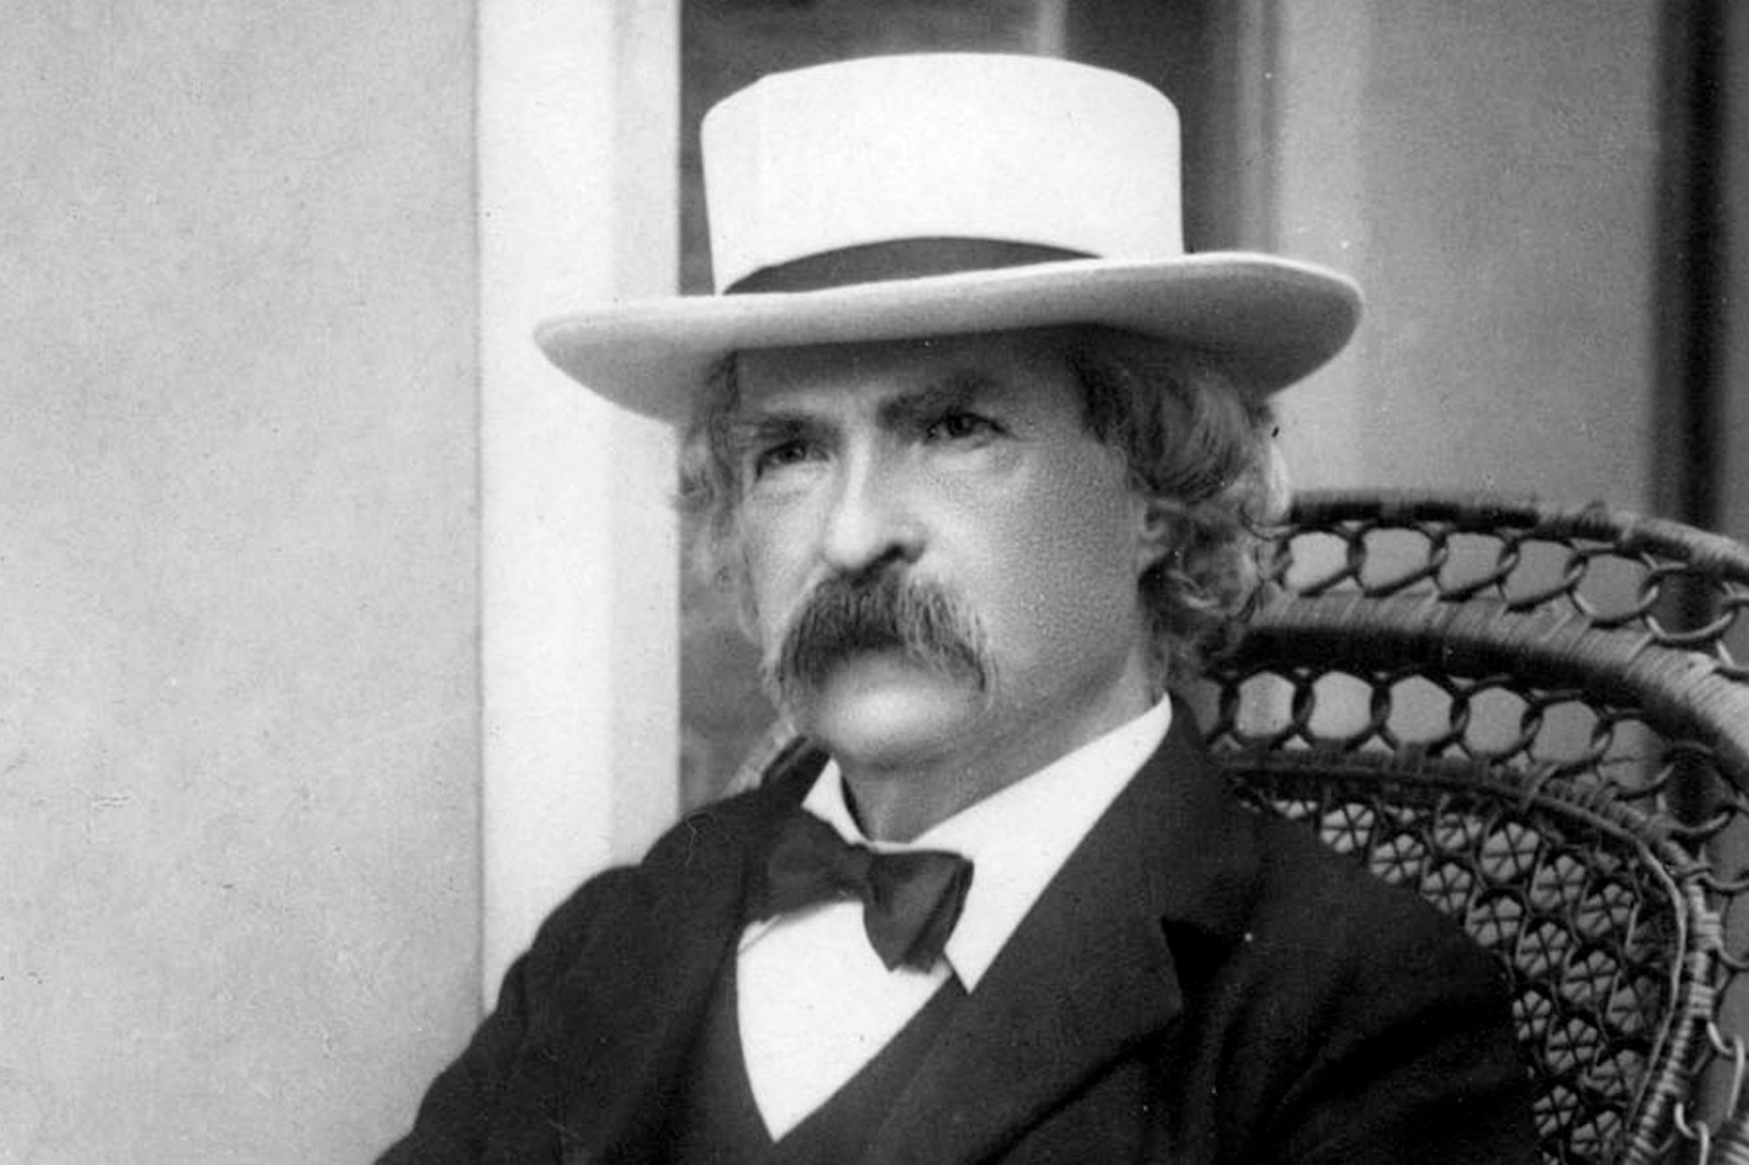
Mark Twain: “Comparison is the death of joy.”

Slide 25
Comparison with other valuation methods
S2AV is similar to TEV, but with key differences:
  Statutory accounting replaced by Solvency II
  Required capital based on SCR, rather than SI solvency margin
S2AV is similar to forward-looking perspective under ORSA, but ORSA:
  is not a valuation standard in itself
  does not deal with issues such as cost of capital
  However, such projections (extended out) could be used as a basis for S2AV

Slide 26
Comparison with other valuation methods
Compared with MCEV and Solvency II (market-consistent)
  S2AV departs from market consistency by allowing for expected real-world investment returns and cost of holding capital for market risks; but we believe this more closely reflects decision-making frameworks
  MCEV only charges “frictional costs” for required capital, together with CRNHR for non-hedgeable risks; SII makes no charge for hedgeable risks, and 6% charge for non-hedgeable
  S2AV allows for COC on un-hedged hedgeable risks, and on non-hedgeable risks (to extent COC differs from that in Risk Margin calculation)
  MCEV (and SII balance sheet) not really forward-looking
  MCEV only “covered business”; S2AV (and SII) covers all types of insurance
  MCEV methodology and assumptions may differ from SII (e.g. contract boundaries, risk-free rates, CRNHR cost of capital), but MCEV Principles© do now allow companies to align these
Copyright© Stitchting CFO Forum Foundation 2008

Slide 27
Further considerations

Slide 28

Warren Buffet: “Price is what you pay, value is what you get”

Slide 29
Further considerations
There may be constraints on profits being distributable other than Solvency II, for instance:
  Formal or informal limits on dividends (e.g. related to local statutory or IFRS profits)
  Other asset coverage requirements
  Non-liquid assets
  Other shareholders/joint ventures
Other, Solvency II related factors include:
  Eligibility of capital/tiering
  Ring-fenced funds
  Group requirements
  Transitional measures

Slide 30
Further considerations (2)
However, we believe generally Solvency II will be the over-riding driver of distributable profits in the mid to long term
=> Better to base valuation on Solvency II metrics (than, say, local statutory profits) and adjust target solvency ratio or make other on-top adjustments
In an M&A context could be synergies with existing operations (e.g. diversification benefits in SCR calculation)
Some may object to a real-world view; but this paper is aimed at those with such a view (e.g. investors). Note that forward-looking projections under ORSA take a similar view

Slide 31
S2AV in real-life M&A
Own Funds
Cost of capital for non-hedgeable risks
Adjust own funds to get economic value (e.g. ineligible OF, sub-debt)
Minimum info: Solvency II balance sheet and details of own funds
Adjust for: investor’s required rate of return, target capital (% of SCR), tax
Minimum info: underlying calculation of Risk Margin
Hedgeable risks
Franchise value
Adjust for: shareholders’ share of uplift less cost of capital
Minimum info: underlying calculation of Risk Margin; SCR built up from sub-modules; asset values by type; DTA/DTL; mix of guarantees and profit sharing mechanism for par business
One year’s NBV and multiplier
Minimum info: information on key new business products (e.g. loadings etc) or NBV on an MCEV or similar basis; details of contract boundaries; projected new business volumes

Slide 32
S2AV in real-life M&A (2)
It might be felt that the calculations required for S2AV are complex, and other, existing methods might be more appropriate. However:
Many of the key results can be obtained from the Solvency II balance sheet, SCR and some basic underlying calculations
Different levels of sophistication can be applied, depending on the data available, timescales etc
S2AV allows different components of the value to be considered separately, and hence the possible impact of post-transaction actions to be assessed
As we have discussed, other methods simply do not provide a good view of distributable profits

Slide 33
S2AV in real-life M&A (3)
Projections likely to be available (such as from business plans) will have various issues:
  Limited projection period (e.g. 3 – 5 years)
  Based on some measure such as IFRS which doesn’t help determine distributable profits in a Solvency II world
  Underlying approximations and potential inconsistencies in calculations
  Even the projections underlying ORSA (which would be expected to show projected own funds and SCR) are likely to be based on approximate methods (e.g. risk-driver approaches) and, again, will have a limited projection period.

Slide 34
S2AV in real-life M&A (4) – miscellaneous issues
The standard formula doesn’t allow for all risks (e.g. sovereign debt)
  Typically this will be allowed for approximately via target capital
Transitional measures
Simplicity / conservativism
  This is an issue for any measures of value.
Impact of tax
  Potentially complex regardless of the valuation method
Other constraints on distribution of surplus such as local statutory accounting etc. This may be allowed for via target capital
Standard formula vs alternatives like internal models and USPs

Slide 35
New business value and profitability

Slide 36

Moby: “There should almost be subjective emotional criteria for evaluating work, instead of just profitability”

Slide 37
Introduction to S2NBV
Our method:
  Reflects marginal capital required for NB, together with cost of holding that capital:
    based on shareholders’ required rate of return
    including for market risks
  Considers marginal impact of NB on SII OF
  Considers projected real-world view
  Allows appropriate assessment of impact of different product designs and other management decisions
  Applicable to life, non-life, health
  => Framework for robust decisions around new business

Slide 38
Introduction to S2NBV (2)
S2NBV = NPV of expected future distributable profits on SII basis, discounted at shareholders’ required rate of return
This is marginal impact of writing new business, e.g.:
  Diversification benefit with capital on existing business
  Impact on ALM position (e.g. pooled fund)
  Tax position
  Spreading of overhead expenses
Standalone view can introduce material distortions
New business consistent with SII contract boundaries
Framework is consistent with S2AV

Slide 39
Introduction to S2NBV (3)
S2NBV =
  Initial OF (OF_{NB})
  Less COC from non-hedgeable risks (compared with RM)
  Plus impact of taking hedgeable risks
Under certain conditions:
S2NBV = OFNB
Impact of taking hedgeable risks includes:
  Cost of additional capital
  Additional real-world returns above risk-free
  Impact on value of liabilities (e.g. TVFOG)
S2NBV margin = S2NBV / PVNBP

Slide 40
Product design and risk management
SII attempts to reflect actual risks taken in capital requirements (although Pillar I Standard Formula doesn’t reflect all risks)
Market-consistent approaches to NB profitability don’t allow appropriately for taking market risks, shareholders’ return on capital, or potential upside from management decisions
  In fact in products with asymmetries in liabilities leading to TVFOG a completely de-risked strategy will usually give the highest value of new business under MCEV
Under S2NBV various factors influence value, including:
  Product design and pricing (including policyholder options and guarantees)
  Management actions
  Policyholder behaviour
  Existing SII balance sheet
  Assumed volume and mix of new business
  Prevailing economic conditions

Slide 41
Life Par example
Simplified example, profit sharing based on book value returns, standalone basis
Base case: minimum guarantee 1% p.a.; minimum margin 1%; 100% profit sharing (for returns above min guarantee + margin)
Case A: minimum guarantee 0% instead of 1%
Case B: profit sharing based on 80% of investment returns, with no minimum margin (but still subject to 1% guarantee)
Case C: negative bonuses allowed (subject to minimum guaranteed interest rate being payable on maturity or surrender)
Case D: market value adjustment of 50% of unrealized asset losses on surrender

Slide 42
Life Par example (2)

Slide 43
Life Par example (3)

Slide 44
Life Par example (4) – marginal basis for capital
Consider the impact, in respect of capital, of writing the new business together with thee example blocks of in-force life business with different characteristics:
 | S2NBV margin | NPV (SCR) / NPV (TP)
Standalone | -0.1% |  | 5.0%
Marginal - similar in-force life block | -0.1% |  | 4.9%
Marginal - small, dissimilar in-force life block | 0.6% |  | 3.6%
Marginal - large, dissimilar in-force life block | 1.0% |  | 2.7%

Slide 45
Life Par example (5) – marginal basis for capital

Slide 46
Life Par example (6) – marginal basis for capital
Further diversification benefit also achievable between BSCR modules (not shown)

Slide 47
Life Par example (7) – marginal basis, further aspects
In our example, new business can be written in a pooled fund with in-force
Can have significant impact on ALM position, e.g. premium cash-flows reducing the need to sell assets to meet liability outgo
Impact of pooling returns to calculate profit sharing
If book value yields on in-force are higher than “new money yields” related to new business, can get:
  Lower profit sharing on in-force (depending on guarantees) => positive impact on shareholder profits
  Higher profit sharing on new business (depending on guarantees) => negative impact on shareholder profits
  Overall impact on value dependent on relative level of yields and guarantees and can be positive or negative

Slide 48
Non-life example
Assume two business lines:
  Motor Other, i.e., excluding MTPL
  GTPL
No market risk taken
Payment pattern has an impact on timing of capital release:

Slide 49
Non-life example (2)
Breakdown of S2NBV margin by business line:
 | OF_{NB} (before impact of RM_{NB}*(1-tax)) | -RM_{NB}*(1-tax) | COC non-market risks in excess of RM_{NB}*(1-tax) | S2NBV margin
Motor | 9.1% | -2.1% | -2.1% | 4.9%
GTPL | 11.4% | -6.1% | -5.3% | 0.0%
Mix | 10.3% | -3.6% | -3.1% | 3.5%

Slide 50
Non-life example (3)
Analysis of difference in S2NBV margin between Motor and GTPL:

Slide 51
Non-life example (4) – impact of investing in equities

Slide 52
Other considerations
These techniques can be used to measure S2NBV overall, and then build up total franchise value
S2NBV margin can be volume-dependent, particularly due to marginal effects => need to make assumptions about volumes for product pricing
Similarly, S2NBV for a particular period should consider all lines (including both life and non-life)
For franchise value impact of such effects can vary over time (e.g. as risk profile changes); approximate methods can be used to allow for this
Could consider higher pre-issue discount rates to reflect additional uncertainty
Care with SII contract boundaries; for pricing a product with a short boundary, may be appropriate to value future recurrent premiums as future new business (to ensure correct SII Technical Provisions and SCR), with appropriate allowance for lapses, acquisition costs etc

Slide 53
Conclusions

Slide 54

Yoda: “You must unlearn what you have learned”

Slide 55
Conclusions / Recap
S2AV = NPV(distributable profits) @ shareholders’ required rate of return
Assume most important drivers of distributable profits are required SII capital and OF
Can express in terms of:
  Initial OF
  Less COC from non-hedgeable risks (compared with RM)
  Plus impact of taking hedgeable risks
Allowing for:
  Target solvency ratio
  Real-world uplifts and capital charge from “risky” assets
  Policyholder profit sharing on life par business
  Tax
  etc

Slide 56
Conclusions / Recap (2)
Components more easily valued based on information likely to be available from Solvency II reporting (which also has the advantage of objectivity/supervisory oversight)
Decomposition useful in understanding value of certain activities
Departure from market-consistent methodology
Equally applicable to life, non-life, health
Other constraints on profit distribution best allowed for approximately, e.g. via target capital
S2NBV and S2NBV margin based on same framework.
Allows robust approach to product design
Takes marginal approach
Depends on new business volumes, existing balance sheet etc

Slide 57
Thank you
Any questions?
ed.morgan@Milliman.com
jeremy.kent@Milliman.com

Slide 58
Legal disclaimer
This presentation is intended solely for educational purposes and presents information of a general nature. The information contained in the presentation should not be construed as advice on an individual situation or company and persons should consult qualified professionals before taking specific actions. Neither the authors, nor the authors’ employer have certified the information contained in this presentation or guarantee the accuracy and completeness of such information. The use of the contents of this presentation is voluntary and should not be relied upon unless an independent review of its accuracy and completeness has been performed. Neither the authors not the authors’ employer owe any duty of care to any attendant of this presentation and each expressly disclaims any responsibility for any judgments or conclusions which may result therefrom. Neither the authors, nor the authors’ employer shall have any responsibility or liability to any person or entity with respect to damages alleged to have been caused directly or indirectly by the contents of this presentation

