Slide 1
Introduction to IFRS 17 for Non-Life Actuaries
7 November 2017
Rishav Bajaj, Deloitte
Amerjit Grewal, Deloitte

Slide 2
Disclaimer
The views expressed in this presentation are those of the authors,
Rishav Bajaj and Amerjit Grewal,
of the paper and not necessarily of the
Staple Inn Actuarial Society or Deloitte.
2

Slide 3
What is IFRS 17?
IFRS 17 is the first truly international, comprehensive accounting Standard for insurance, replacing IFRS 4 – an interim Standard that results in widely divergent practices.
The IASB aimed for IFRS 17 to bring:
Consistent accounting for all insurance contracts
Updated information about obligations, risks and performance of insurance contracts
Increased transparency in financial information reported by insurance companies
449 companies – US$13.3tr of total assets
Source: IASB website
3

Slide 4
IFRS 17 is now published
The standard was published by the IASB on 18th May 2017 with an effective date of 1 January 2021
IFRS 17 replaces IFRS 4 – an Interim Standard that allowed widely divergent practices in different regions
IFRS 17 published
Some entities begin implementation process
General questions
Entities finalising implementation
Effective date of IFRS 17
Contentious/specific implementation questions
18 May 2017
Early 2018
Early 2019
2020
2021
* Source: http://www.ifrs.org/news-and-events/2017/05/live-presentations-on-new-insurance-standard/
4

Slide 5
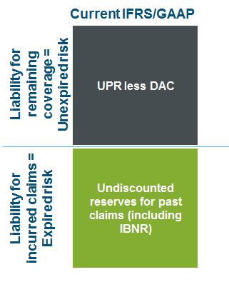
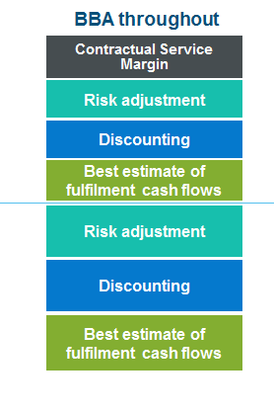
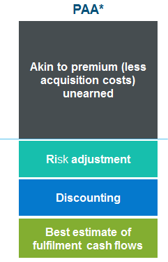
IFRS 17 Technical Overview
Acronym Key
UPR | Unearned Premium Reserve
DAC | Deferred Acquisition costs
IBNR | Incurred But Not Reported
BBA | Building Block Approach
PAA | Premium Allocation Approach
5
Notes:
Measurement model uses a “building block” approach:
1. Expected present value of future cash flows; and
2. Risk adjustment
Measurement is always current
Cash flows
Probability weighting of explicit future cash outflows (less inflows) expected over the fulfilment of the insurance contract, and is updated each reporting period. Cash flows include premiums, claims, incremental policy admin costs, recoveries, incremental acquisition costs
Discount rate
Discount rate based on characteristics of the insurance liability:
- Currency
Duration
Liquidity
What does that mean?
• Insurers will need to develop their approach to determining the risk free rate and methodologies to determine the illiquidity premium.
• Systems and processes will need to be re-configured to discount insurance contracts based on liability characteristics.
Risk Adjustment
Explicitly reported in the financial statements as a component of the insurance contract liability
• Defined as: “the maximum amount an insurer would rationally pay to be relieved of the risk that the
ultimate fulfilment cash flows exceed those expected ultimate fulfilment cash flows exceed those expected”
Methodology for determining risk adjustment not specified – required characteristics are set out
• Re-measured at each reporting period.
What does that mean?
• The inclusion of an explicit risk adjustment is a substantial change from most current The inclusion of an explicit risk adjustment is a substantial change from most current
accounting models for insurance contracts where margins are implicit.
• Calculating probability distributions or stochastic models for insurance liabilities at the portfolio level and developing adequate support for assumptions will require robust and
auditable processes that can bear the scrutiny of market disclosure.
• Selecting the appropriate valuation technique from the three permitted, defining the correct level of aggregation and calibrating the technique to the portfolios could be a challenge for companies to implement and maintain.

Slide 6
Deep dives into IFRS 17 concepts
6

Slide 7
Key areas for todays presentation
Simplified approach (PAA)
Best estimate cash flows
Risk adjustment
Discounting
Contractual service margin (BBA only)
Reinsurance measurement
Level of aggregation / onerous contracts
Transition
Presentation and disclosure
Key:
Focus areas

Slide 8
Premium Allocation Approach (PAA)
Objective: Practical expedient for short-term contracts
Applies equally to insurance and reinsurance (both inwards and outwards) contracts, but they will need to be assessed separately
Expected to be adopted for the majority of general insurance contracts.
Multi-year policies such as construction, retrospective reinsurances (LPTs / ADCs), risk attaching RI etc may not be eligible. Also need to consider contract boundaries.
Key features which may restrict PAA eligibility:
the difference between the incidence of risk earning pattern used under PAA vs CSM earning pattern based on “coverage units”.
Exposure to discount rates driven by the level of discount rates and the length of the claims payout pattern over time.
The impact of positive and negative shocks which would change the unearned profitability assumptions.
When are contracts eligible for the PAA?
OR
If at inception the coverage period is one year or less
If at inception, reasonably expect that measurement would not differ materially from applying the BBA
Not met if expect significant variability in the fulfilment cash flows before a claim is incurred
Variability increases with
Length of contract coverage
Embedded derivatives
8

Slide 9
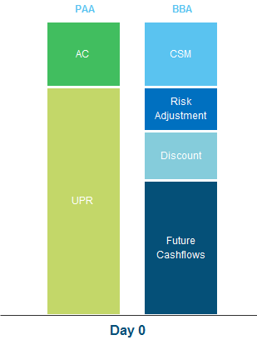
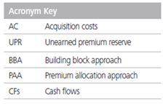
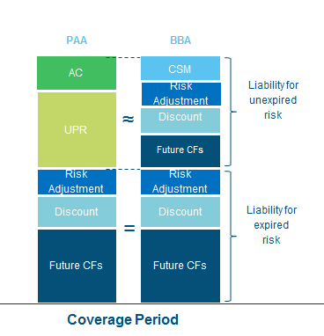
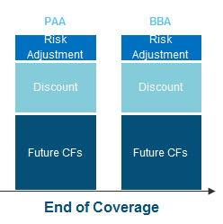
Example of Premium Allocation Approach
9

Slide 10
Level of aggregation / onerous contracts
Objective: Separate profitable and loss making contracts. No CSM at end of coverage period
Step 1: Identify portfolios = insurance contracts subject to similar risks and managed together as a single pool
Contracts in different products lines would be in different portfolios.
Step 2: Divide each portfolio into groups:
contracts issued within the same 12-month period
information about the contracts’ resilience (considered on a gross basis)
consistent with internal reporting
exemption for regulatory pricing
group not reassessed after inception
Fulfilment cash flows may be estimated at a higher level of aggregation than
the group or portfolio => then need to allocate estimates to groups of contracts
PAA: At inception: Assume no contracts in the portfolio are onerous, unless facts and circumstances indicate otherwise
Profitable contracts |  | Contracts that at inception have no significant possibility of becoming onerous subsequently, if any | Unearned profit is recognised as liability and is released as insurance services are provided
 |  | Other profitable contracts, if any
Onerous contracts |  | Contracts that are onerous at inception, if any | A loss is recognised in P/L
10

Slide 11
Risk Adjustment
Level of aggregation/ onerous contracts
Objective: Adjustment to make insurer indifferent between the PV of the uncertain cash flows and the PV of certain cash flows.
Possible methods…?
Value at Risk (VaR)
No prescribed approach
Risk adjustment required on a gross and reinsurance basis separately
Re-measured at each reporting period
Allows for effect of diversification between portfolios within a reporting entity
Regardless of the method chosen, a confidence level equivalent must be calculated and disclosed (i.e. VaR percentile)
Tail Value at Risk (tVaR)
Cost of Capital (CoC)
11

Slide 12
Discounting
Determining discount rate (approach)
Objective: Allowance for the time value of money
6
Top-down
Curve, not a flat rate;
Market data for durations where this is a market;
Long term averages where there is no market.
Discount rate based on characteristics of the insurance liability:
- Currency, duration, and liquidity - Consistent with observable current market inputs for instruments with similar cash flow characteristics
- If amount, timing or uncertainty of cash flows depend on the return from underlying assets, the discount rate should reflect that dependency
R
E
M
O
V
E
Duration mismatches
Reference portfolio rate
Credit risk e.g. expected credit losses
Insurer’s own credit risk
Insurance Liability – Discount Rate
A
D
D
Liquidity premium
Conceptually, both approaches should lead to the same outcome - no proof is required
Risk free rate of return
Bottom-up
4
Both top-down and bottom-up approaches are acceptable – method is not prescribed
Two approaches:
Bottom-Up approach – risk free rates, adjusted to include a liquidity premium
Top-Down approach – expected returns of a reference portfolio, adjusted to eliminate factors not relevant to the liability
12

Slide 13
Presentation and Disclosure
Level of aggregation/ onerous contracts
Objective: Transparency through disclosures. Revenue metrics consistent with other non-insurance industry revenue metrics.
Statement of comprehensive income
Insurance revenue | X
Insurance service expenses | (X)
Reinsurance expenses | (X)
Insurance service result | X
Insurance finance income / (expense) | X/ (X)
Investment income | X
Investment expenses | (X)
Net financial result | X
Administrative expenses | (X)
Other expenses | (X)
Profit or loss | X
Effect of discount rate changes on insurance liabilities | X
Total comprehensive income | X
New look and feel to financial statements including:
Volume based metric of reporting premiums as income is replaced with an insurance revenue line item
Insurers will now split out insurance service result and net financial result when explaining profitability of insurance policies to stakeholders
Additional quantitative reconciliations will are likely to require actuarial input
Additional qualitative disclosures including:
Risk adjustment method and confidence level
Yield curves used to discount cashflows
13

Slide 14
IFRS 17 vs Solvency II
14

Slide 15
IFRS17 Background
Similarities with Solvency II
IFRS 17 and Solvency II both propose a single measurement basis for insurance contract liabilities that are based on prospective cash flows. However, IFRS 17 also retains the idea of recognising profit over the period when insurance cover is provided.
15

Slide 16
Differences between IFRS 17 and Solvency II
Topic | IFRS 17 | Solvency II
Recognition | Earliest of start of coverage and premium receipt (plus onerous contract test) | Date party to contract
Measurement model | Building Block Approach (BBA), or Premium Allocation Approach (PAA) for eligible contracts | No choice
Discount Rate | Company specific, principles based | Prescribed
Risk Allowance | Risk Adjustment - no prescribed method | Risk Margin - prescribed 6% cost of capital
Contractual Service Margin | Eliminates day-one gain (measure of unearned profit) | No similar concept
Other Comprehensive Income (optional) | Removes impact of discount rate changes from P&L | No similar concept
16

Slide 17
How will IFRS 17 change your role?
17

Slide 18
IFRS 17 project timeline
The ideal timeline for implementing IFRS 17 will depend on the complexity of the changes required to the underling systems and processes for financial reporting.
Don’t forget lessons learned from Solvency II…
Build and implement
Actuaries need to be integrated and integral to Finance process
Test and Dry run
Controls and documentation need to be updated
Design new TOM
Effort/Spend
Handover and embed
Don’t leave things to the last minute
Impact assessment and business case
Reconciliations can be time consuming
Technical issues can be surprisingly time consuming
Planning
Train, train and train again
2017
2018
2019
2020
2021
Training the Board early, as well as other stakeholders is key
Programme Phase
18

Slide 19
How does this impact the actuary?
Technical
Measurement model choice (PAA vs BBA)
Risk adjustment approach
Level of aggregation / onerous contracts
Understanding the impact on profitability
Increased volatility in results
Metrics for performance management
Calculations and reconciliations
The Actuary
More detailed disclosures
New processes and systems
Consistency with regulatory messaging
Data requirements
Preparing investors for change
Technical understanding
Managing the messages to market
Operational
Working Day Timetable impact
Change in role
KPI’s and MI
Interaction between Pricing, Reserving and Capital
19

Slide 20
Questions
Comments
Rishav Bajaj, Senior Consultant, Deloitte
Email: risbajaj@deloitte.co.uk
Telephone: +44 20 7303 3624
Amerjit Grewal, Senior Consultant, Deloitte
Email: amegrewal@deloitte.co.uk
Telephone: +44 20 7303 6037
20

